Slide 1
Prediction of West Nile Virus in Chicago

Slide 2
Introduction and Objective
Presence of west nile virus first detected in Chicago in 2002
Surveillance program started to track and prevent outbreak
Objective: develop a machine learning model in order to improve resource allocation

Slide 3
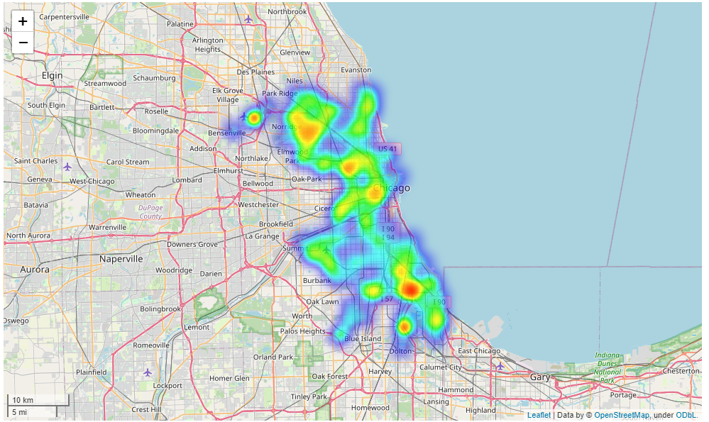
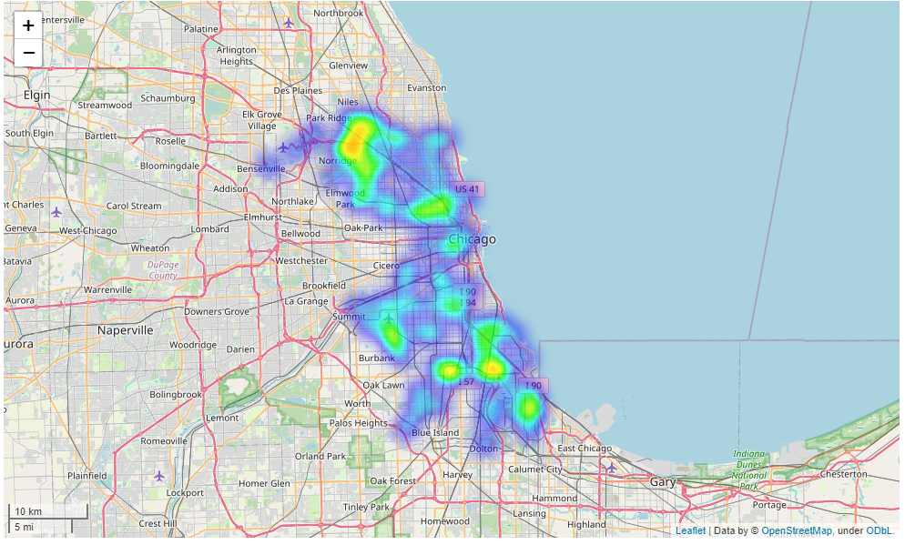
Exploratory Analysis
Heatmap of all samples
Heatmap of positive samples

Slide 4
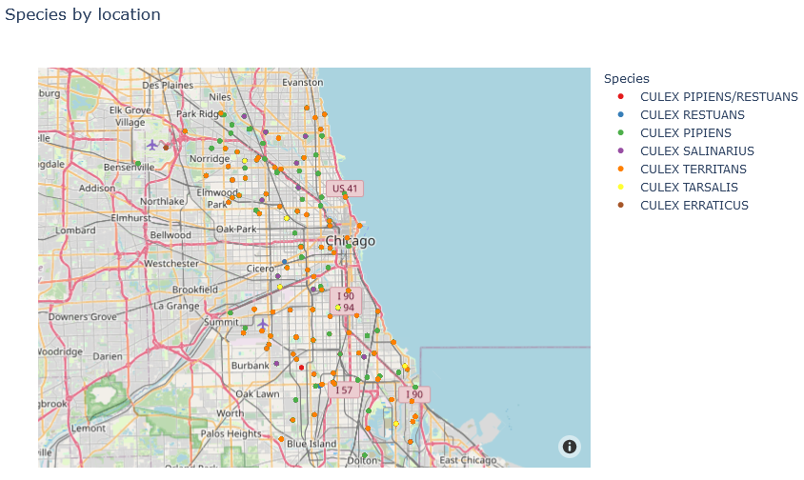
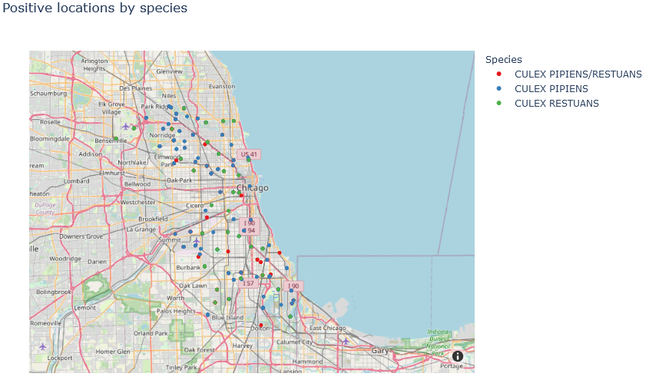
All species by location
Positive species by location

Slide 5
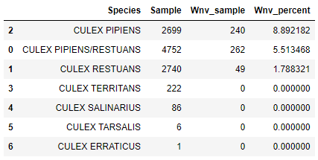
Species exhibiting WNV

Slide 6
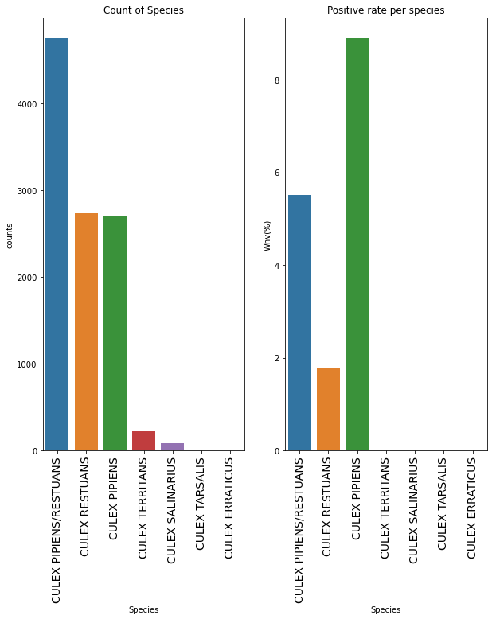
Count of species and positivity rate per species
4 species do not carry WNV
Only 3 seen to be carriers

Slide 7
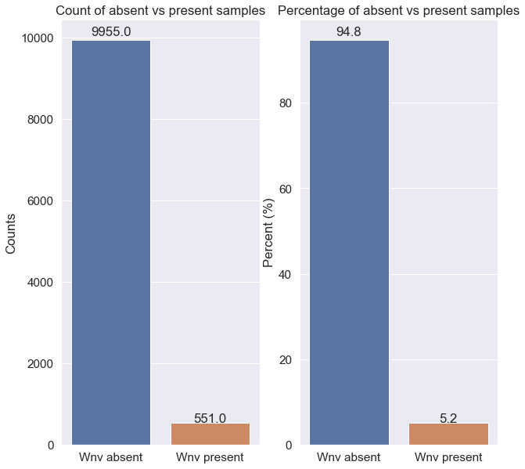
Count & percentage of absent vs present samples

Slide 8
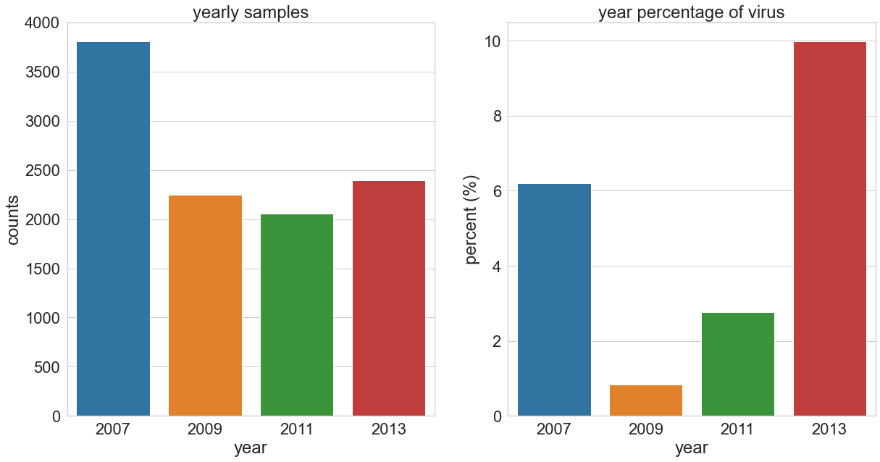
Yearly sample & positive rate

Slide 9
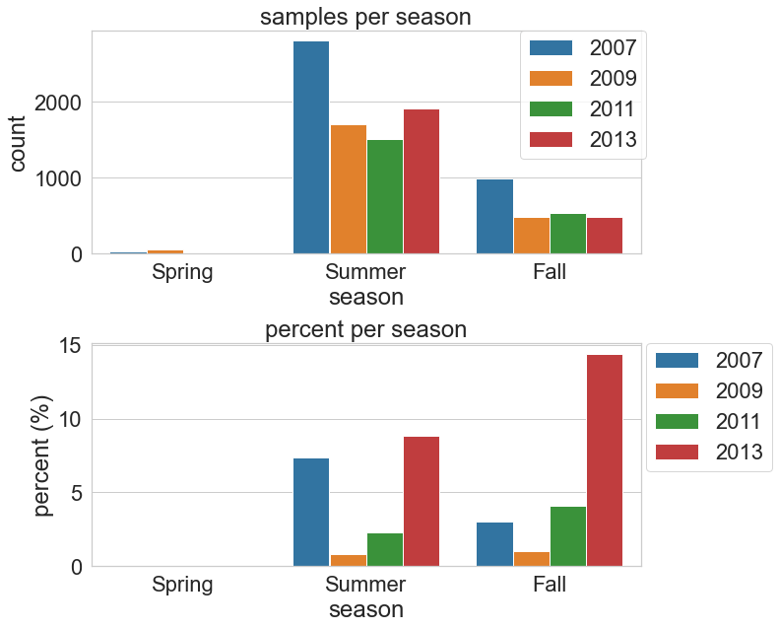
Samples and Rate per season
Most samples taken during summer
2013
Higher virus presence
Higher presence in fall

Slide 10
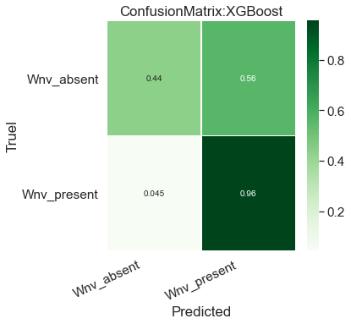
Data Modeling
XGB classifier used
Compared with random forest classifier
Five-fold cross validation used for grid search for parameters
Final XGB model results
96% accurate – present
44% accurate – absence
False positive is more acceptable than false negative
False negative would result in further unpredicted spread
Confusion matrix: final XGB model

Slide 11
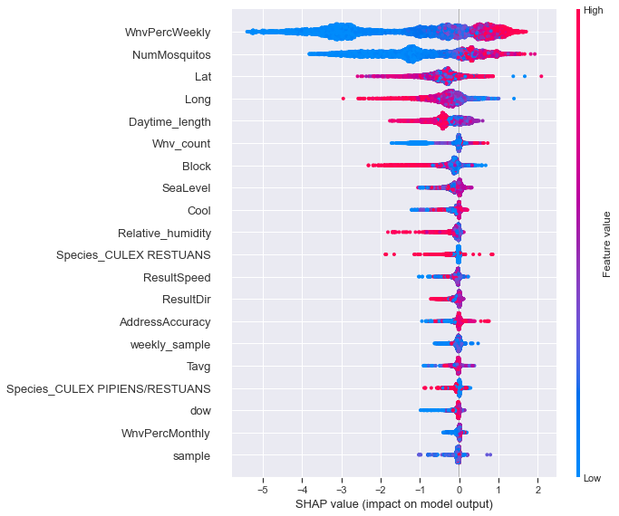
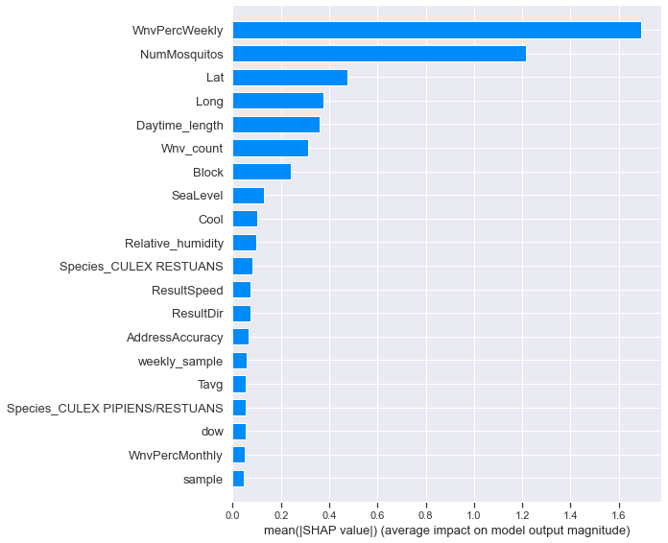
Feature Importance
Shap summary
Shap values

Slide 12
Conclusions and Recommendations
Conclusions:
Refined XGB model can provide 96% accuracy-present and 44% accuracy-absence
Only 3 species appear to carry WNV in Chicago
NOTE: remaining species had very low sample counts
Recommendations:
Expansion of testing is recommended.
Would allow to further study on which species carry WNV
Would allow further model training and refinement
More test sites would allow more accurate mapping of data

